Slide 1
AB176 – what we learned

Slide 2
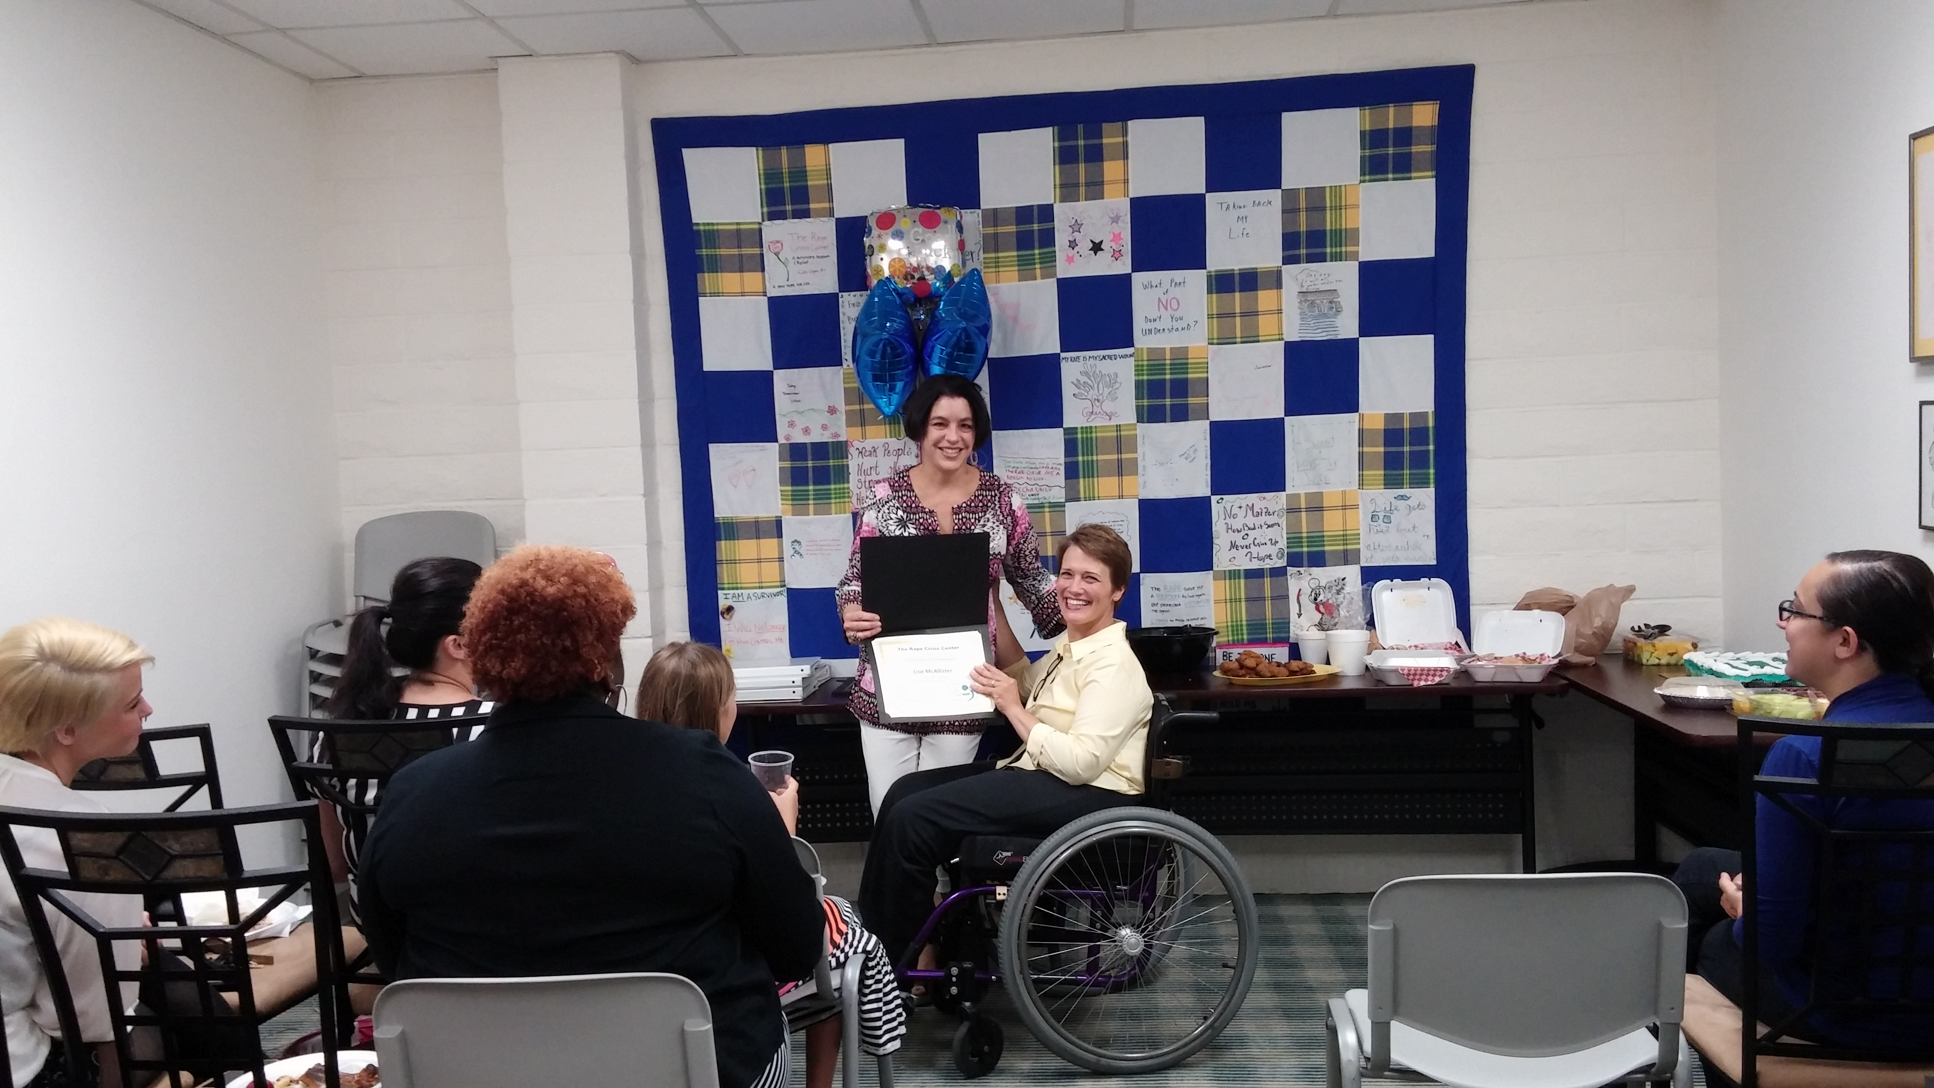

Slide 3
Sexual assault Advocacy
Crisis Response and Support
Hotline – 888-366-1640/702-366-1640
Trained advocates answer the hotline 24 hours a day/7 days per week
Online chat on our website or text – 725-900-2640 rcclv.org
7 days per week from 10 am – 4 pm
Advocates respond to sexual assault victims at the hospital 24 hours a day/ 7 days per week
In person response at LE Area Commands for Delayed Reports
Services provided at the hospital
-Clothing Assistance -Transportation Assistance
-Basic Information -Referrals to other services
-

Slide 4
Sexual Assault advocacy – Long term
Law Enforcement assistance – how to get a police report, understand the investigation process
Victims of Crime Compensation – county and state application assistance and submission
Court Advocacy – accompanying victims to various court hearings, helping victims understand the process, sentencing, parole and probation accompaniment
Student Advocacy – working with K-12 students on issues related to school that may be a result of or impacted by the assault/abuse
Youth and Family Advocacy – working with families of pre-school aged children and families impacted by child sexual abuse, particularly when the perpetrator is a family member
PREA – working with incarcerated and detained survivors of sexual violence, and those who are assaulted while in detention
Community Resources and Referrals (housing, food, travel)

Slide 5
Rural advocacy
Rural programs that we spoke to had advocates, but generally rely on a small number of paid staff who are already working beyond capacity
Few of the rural programs we worked with had a significant volunteer program, and could benefit from building a program to engage volunteers – we attempted to support in this with the accessibility of online training that we produce, and offering access to staff and volunteers for onboarding or ongoing training opportunities
Numerous challenges to access and engagement with services in rural areas were identified –
Transportation
access to exams within a reasonable distance
fear of the person you reach out to for assistance knowing or having a connection to the perpetrator
overall fear of victim blaming
lack of overall community education on sexual assault

Slide 6
successes
The training curriculum developed was accredited by the National Advocate Credentialling Program
The online system funded through the grant is very robust, customizable, and numerous “tracks” and courses can be developed for particular areas
Numerous resources in the rural counties were added to our online resource database, which is now available via our website to all volunteers, so if individuals from rural areas contact the hotline, they can be better assisted

Slide 7
successes
Stronger relationships with Nye and Lincoln county organizations were formed
The clear need for greater support in community education in the rural areas was brought up, and is something we are working on moving forward
Even with the pandemic, there were opportunities to provide information to additional individuals and organizations in the rural areas about sexual assault advocacy and general information
We have created some additional service partnerships when needed

